Slide 1
LOGIC GATES
Introduction to Basic Digital Building Blocks
By Purushottam mahajan

Slide 2
What is Logic Gates
Logic gates are electronic devices that perform logical operations on one or more binary inputs to produce a single binary output.
They are fundamental components in digital electronics, allowing for the manipulation and processing of binary data.
Logic gates form the foundation of digital circuits and are essential for performing arithmetic, decision-making, and control functions.
ogic gates perform basic logical operations, including AND, OR, and NOT.

Slide 3
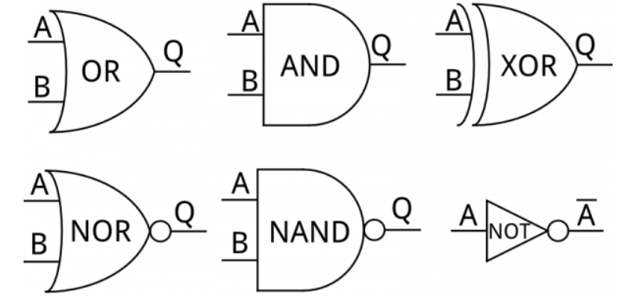
Types of Logic Gates
AND Gate
OR Gate
NOT Gate
NAND Gate
NOR Gate
XOR Gate
XNOR Gate

Slide 4
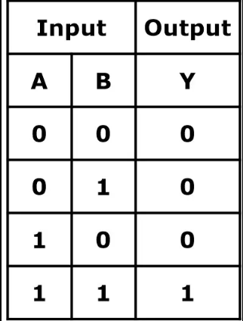
AND Gate
An AND gate is a logic gate that produces a HIGH output (1) only when all of its inputs are HIGH (1).
It implements the logical conjunction operation, where the output is true (1) if and only if all inputs are true (1).

Slide 5
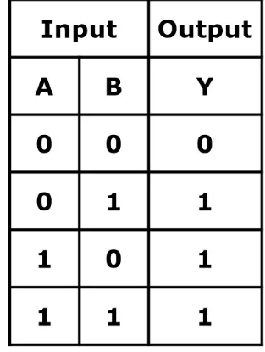
OR Gate
An OR gate is a logic gate that produces a HIGH output (1) if any of its inputs are HIGH (1).
It implements the logical disjunction operation, where the output is true (1) if at least one input is true (1).

Slide 6
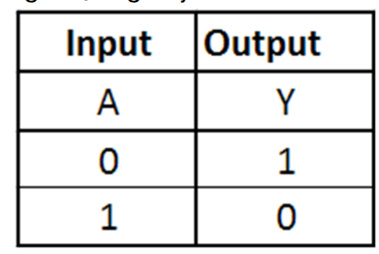
NOT Gate
A NOT gate, also known as an inverter, is a basic digital logic gate that produces the logical negation of its input.
It takes a single input and produces an output that is the opposite (complement) of the input.

Slide 7
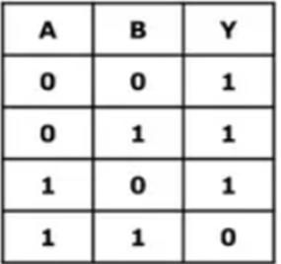
NAND Gate
A NAND gate is a digital logic gate that produces the logical negation of the AND operation.
It produces a LOW output only when all inputs are HIGH; otherwise, it produces a HIGH output.

Slide 8
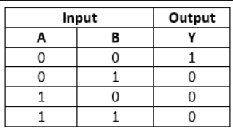
NOR Gate
A NOR gate is a digital logic gate that produces the logical negation of the OR operation.
It produces a HIGH output only when all inputs are LOW; otherwise, it produces a LOW output.

Slide 9
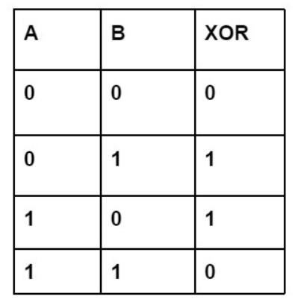
XOR Gate
An XOR gate (Exclusive OR gate) is a digital logic gate that produces a HIGH output (1) if the number of HIGH inputs is odd.
It produces a HIGH output only when the number of HIGH inputs is odd; otherwise, it produces a LOW output.

Slide 10
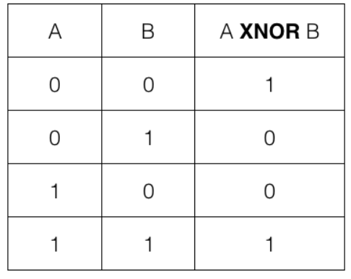
XNOR Gate
An XNOR gate (Exclusive NOR gate) is a digital logic gate that produces a HIGH output (1) if the number of HIGH inputs is even.
It produces a HIGH output only when the number of HIGH inputs is even; otherwise, it produces a LOW output.

Slide 11
Practical Applications
Digital Circuits
Computer Architecture
Boolean Algebra
Control Systems
Robotics
Communication Systems

Slide 12
Properties of Logic Gates
Commutative
The commutative property states that the order of inputs in a logic operation does not affect the result.
Associative
The associative property states that the grouping of inputs in a logic operation does not affect the result.
Distributive
The distributive property states that a logic operation distributes over another logic operation.
Identity
The identity property states that there exist specific inputs that do not affect the result of a logic operation.
De Morgan's Theorem
De Morgan's Theorem provides a relationship between logic operations involving negation.

Slide 13
THANK YOU!

